Slide 1

Stabilized + Growth Self Storage Properties
Strategic Storage Trust IV, Inc.
This property is not owned by Strategic Storage Trust IV, Inc. This property is owned by our sponsor.
This property is not owned by Strategic Storage Trust IV, Inc.
Name – Title
This is neither an offer to sell nor a solicitation of an offer to buy the securities described herein. Only the prospectus makes such an offer. The literature must be read in conjunction with the Prospectus in order to fully understand all of the implications and risk of the offering of securities to which it relates. Please read the Prospectus in its entirety before investing for complete information and to learn more about the risk associated with this offering. No offering is made to New York residents except by a Prospectus filled with the Department of Law of the State of New York. The Attorney General of the State of New York has not passed on or endorsed the merits of this offering.

Slide 2
Risk Factors & Other Information
We are an “emerging growth company” under the federal securities laws and will be subject to reduced public company reporting requirements. Investing in our common stock involves a high degree of risk. You should purchase these securities only if you can afford a complete loss of your investment. See “Restrictions on Ownership and Transfer” beginning on page 162 to read about limitations on transferability. See “Risk Factors” beginning on page 25 to read about the risks you should consider before buying shares of our common stock. The most significant risks include the following:
As of September 30, 2019, our accumulated deficit was approximately $13.1 million, and we anticipate that our operations will not be profitable in 2019.
We have paid, and may continue to pay, distributions from sources other than our cash flows from operations, including from the net proceeds of our public offering and the private offering transaction. We are not prohibited from undertaking such activities by our charter, bylaws, or investment policies, and we may use an unlimited amount from any source to pay our distributions, and it is likely that we will continue to use public offering proceeds to fund a majority of our early distributions. For the years ended December 31, 2017 and 2018, we funded 100% of our distributions using proceeds from our private offering transaction and our public offering. For the nine months ended September 30, 2019, we funded 5.4% of our distributions using cash flows from operations, 46.6% using proceeds from our public offering, and 48.0% using proceeds from our distribution reinvestment plan. Payment of distributions in excess of earnings may have a dilutive effect on the value of your shares. If we pay distributions from sources other than cash flow from operations, we will have fewer funds available for acquiring properties, which may reduce our stockholders’ overall returns. Additionally, to the extent distributions exceed cash flow from operations, a stockholder’s basis in our stock may be reduced and, to the extent distributions exceed a stockholder’s basis, the stockholder may recognize a capital gain.
No public market currently exists for shares of our common stock and we may not list our shares on a national securities exchange before three to five years after completion of this offering, if at all; therefore, it may be difficult to sell your shares. If you sell your shares, it will likely be at a substantial discount. Our charter does not require us to pursue a liquidity transaction at any time.
This is an initial public offering; we have limited operating history, and the prior performance of real estate programs sponsored by affiliates of our sponsor may not be indicative of our future results.
This is a “best efforts” offering. If we are unable to raise substantial funds in this offering, we may not be able to invest in a diverse portfolio of real estate and real estate-related investments, and the value of your investment may fluctuate more widely with the performance of specific investments.
We are a “blind pool.” As a result, you will not be able to evaluate the economic merits of our future investments prior to their purchase. We may be unable to invest the net proceeds from this offering on acceptable terms to investors, or at all.
Investors in this offering will experience immediate dilution in their investment primarily because (i) we pay upfront fees in connection with the sale of our shares that reduce the proceeds to us, (ii) on January 25, 2017 we sold approximately 360,577 shares of our Class A common stock at a purchase price of approximately $20.80 per share in a private offering transaction as described above, and (iii) we paid offering expenses in connection with our private offering transaction.
There are substantial conflicts of interest among us and our sponsor, advisor, property manager, transfer agent and dealer manager.
Our advisor will face conflicts of interest relating to the purchase of properties, including conflicts with SmartStop Self Storage REIT, Inc. and the advisors other private programs sponsored by our sponsor, and such conflicts may not be resolved in our favor, which could adversely affect our investment opportunities.
We have no employees and must depend on our advisor to select investments and conduct our operations, and there is no guarantee that our advisor will devote adequate time or resources to us.
We will pay substantial fees and expenses to our advisor, its affiliates and participating broker-dealers, which will reduce cash available for investment and distribution.
We may incur substantial debt, which could hinder our ability to pay distributions to our stockholders or could decrease the value of your investment.
We may fail to qualify as a REIT, which could adversely affect our operations and our ability to make distributions.
Our board of directors may change any of our investment objectives without your consent.
OTHER INFORMATION
We encourage you to review our SEC filings at www.sec.gov.
An investment in our shares is not suitable for all investors. An investment in our shares involves significant risks and is only suitable for persons who have adequate financial means, desire a relatively long-term investment and will not need immediate liquidity from their investment. Investors should only purchase shares if they can afford a complete loss of their investment. Generally, a purchaser of shares must have, excluding the value of a purchaser’s home, furnishings and automobiles, either:
a net worth of at least $250,000: or
a gross annual income of at least $70,000 and a net worth of at least $70,000.
Please see the prospectus for a full description of suitability standards. Residents of Alabama, Iowa, Kansas, Kentucky, Maine, Massachusetts, Missouri, Nebraska, New Jersey, New Mexico, North Dakota, Ohio, Oregon, Pennsylvania, Puerto Rico, Tennessee and Vermont should consult the prospectus for details regarding the more stringent suitability standards that apply to them based on their states of residence.

Slide 3




Agenda
SmartStop Asset Management, LLC
Why Self Storage?
Strategic Storage Trust IV, Inc.

Slide 4
SmartStop Asset Management, LLC

Slide 5
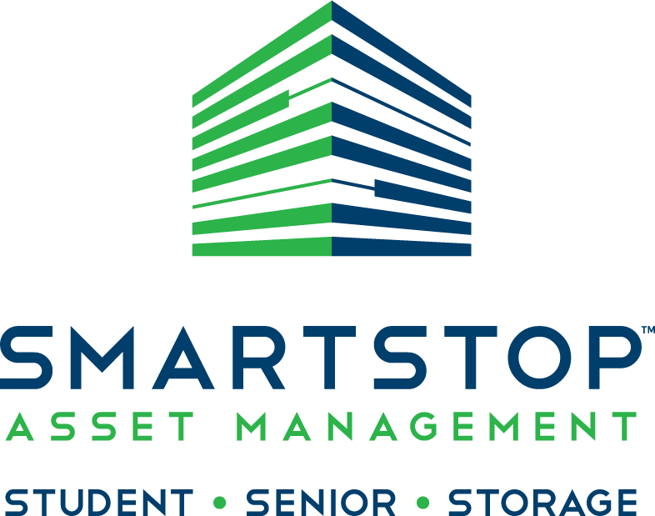
SmartStop Asset Management, LLC
SmartStop Asset Management, LLC (“SAM”) and its affiliates* have a
managed real estate portfolio of approximately $2.0 billion.
An affiliate* of SAM sponsors, advises and manages one public, non-traded REIT and one private REIT focusing on self storage properties
Growing self storage portfolio of properties in the greater Toronto area, comprising over 1 million net rentable square feet
Company and affiliates have acquired over $6 billion in real estate assets over the past 15 years
National sponsor of 1031 DST programs
Current managed portfolio comprises approx. 12 million rentable square feet across 22 states & Toronto, Canada
SAM and its affiliates have an aggregate of over 380 employees, including 42 self storage employees in Toronto, Canada
Experienced developer of self storage and mixed-use properties in the U.S. and Toronto, including ground up & redevelopment projects
Sponsor of public, non-traded REIT investing in student & senior housing
*Self Storage REITs are sponsored by SmartStop REIT Advisors, LLC., an affiliate of SAM

Slide 6






Strategic Storage Trust IV, Inc. Executive Team
H. Michael Schwartz
Chairman of the Board &
Chief Executive Officer
Michael McClure
President
Wayne Johnson
Chief Investment Officer
Matt Lopez
Chief Financial Officer
& Treasurer
Gerald Valle
Senior Vice President
Self Storage Operations
Nicholas Look
Secretary

Slide 7
Why Self Storage?

Slide 8

Why Self Storage?
Total Self Storage Rentable Space in the U.S.
is now 2.3 Billion Square Feet⁽¹⁾
Unique Ability to Add Value as an Operating Business
Low Capital Expenditure Requirements
No Leasing Commissions⁽²⁾
No Tenant Improvements
Recession Resistant⁽³⁾
Hedge Against Inflation & Increasing Interest Rates (Due to month-to-month Rent)
"The self storage industry has been one of the fastest-growing sectors of the U.S. commercial real estate industry over the last 40 years.⁽¹⁾"
2018 Self-Storage Almanac
We will not pay commissions in connection with the leasing of our self storage units; however, we will pay certain fees associated with the day-to-day management.
“Demand for storage is driven by major demographic trends which are going to happen regardless of GDP growth rates, unemployment or what the S&P 500 is doing. . . accordingly, [self] storage is recession resistant.” Source: “Gates: Recession-resistant property is best for investors” - Austin Business Journal by Cody Lyon, Staff Writer, September 2011. Past performance is no indication of future results. It is possible to lose money on this investment. While the self storage industry may be resistant to recessions, there is no guarantee that a related investment will realize a profit or prevent against loss.

Slide 9




Why Self Storage?
Nearly 10% of United States households currently rent a self storage unit, up from 1 in 17 in 1995 according to the Self Storage Association “Industry Fact Sheet” (7/15).
SELF STORAGE FACT
Drivers of Self Storage Usage
Marital Status Change
Birth & Inheritance
Military Deployment
Downsizing by Empty Nesters & Baby Boomers
Job Relocation
Business Expansion or Contraction
Who Uses Self Storage?*
77%
Residential
19%
Commercial
2%
Military
2%
Student
*2018 Self-Storage Almanac

Slide 10
Strategic Storage Trust IV, Inc.

Slide 11
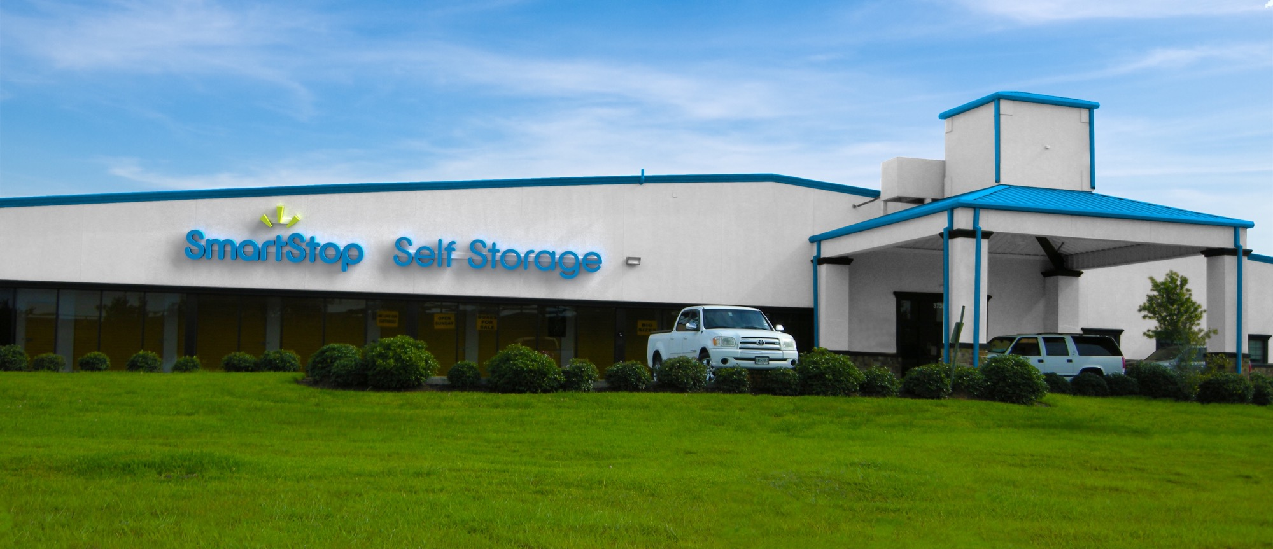

Strategic Storage Trust IV, Inc.
Stabilized + Growth
Self Storage Properties
Strong Market Demographics
Institutional Management

Slide 12
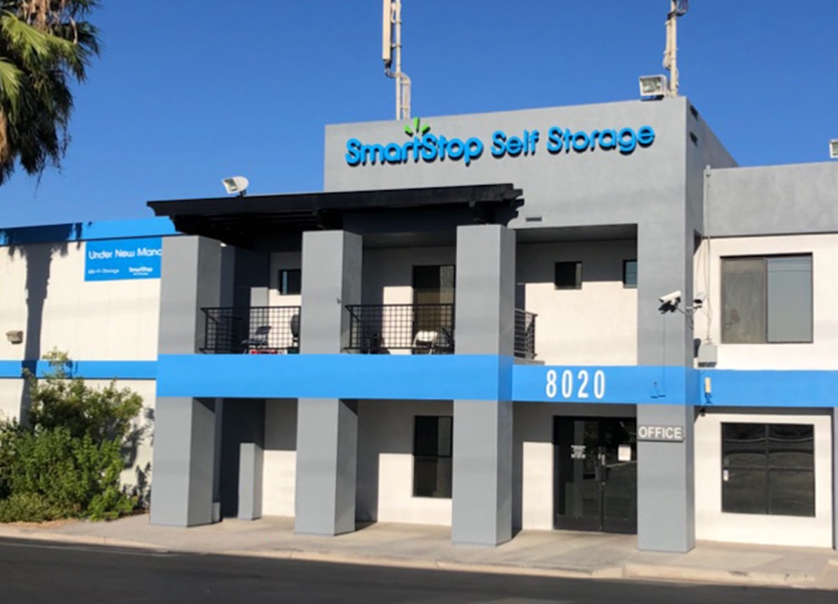
Income Property Focus
Approximately 75% Allocation
Targeting Facilities With Strong Physical Occupancy
Potentially Under Occupied Economically, Increasing Future Cash Flows
Revenue-Optimizing Algorithms Utilized To Increase Rent Per Square Foot (RPSF) And Reduce Discounts

Slide 13
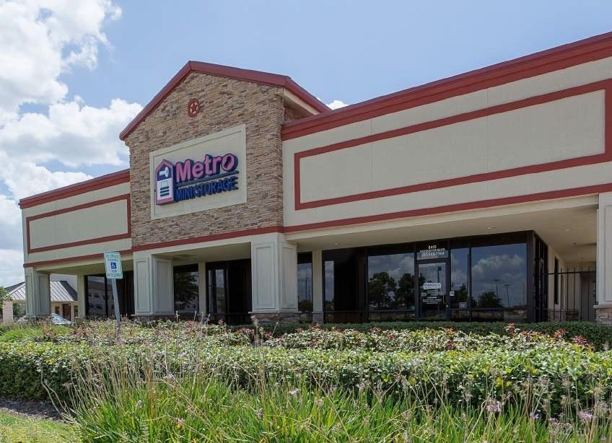
Growth Property Focus
Student & Senior Housing
Approximately 25% Allocation
Certificate of Occupancy /
Lease Up / Development / Redevelopment / Expansion
Has Not Yet Reached Stabilization
Existing Management Unable to Boost Occupancy
Institutional Management and Marketing Make a Difference!

Slide 14

Strong Market Demographics
Demographics
Concentrated in Markets with Growth and Large Surrounding Populations and Income
Achieved a Portfolio Wide Average 3 Mile Population Radius of Between 85,000 - 120,000
Average Income Metrics of Approximately $65k - $80K / Household, Median Income of Approximately $50k - $65K / Household

Slide 15
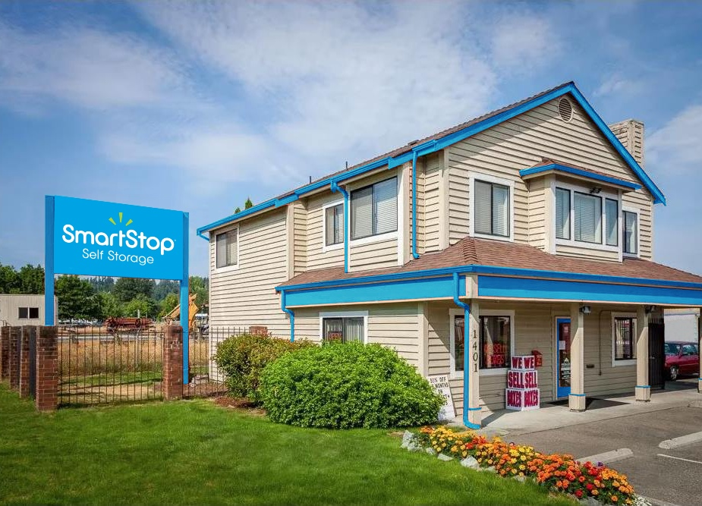
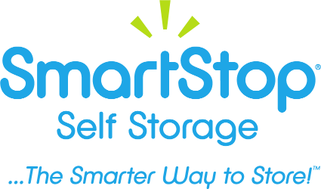
Institutional Management
Economies of Scale
Institutional Marketing Platform
Expense Efficiencies
Institutional Hiring, Training and Management

Slide 16
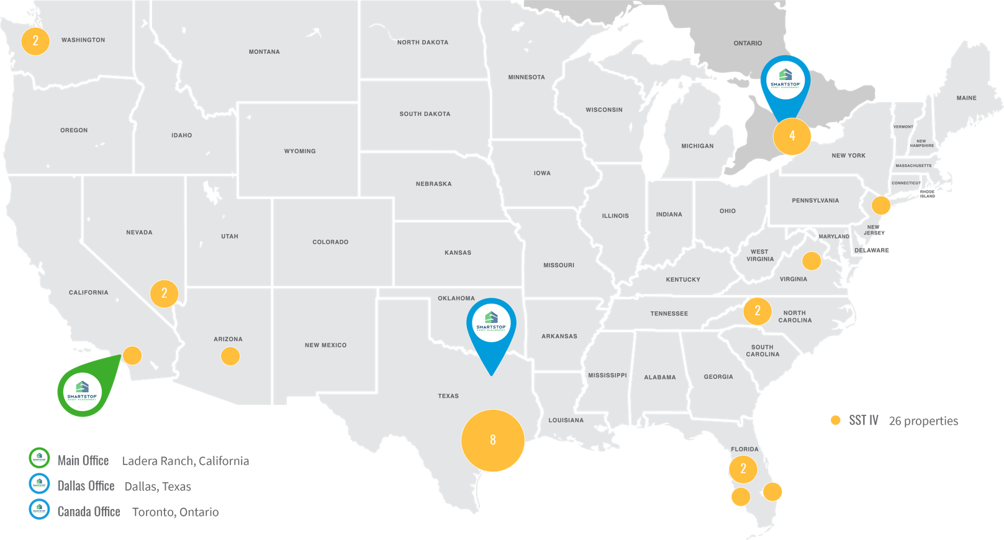
Strategic Storage Trust IV, Inc. Properties

Slide 17
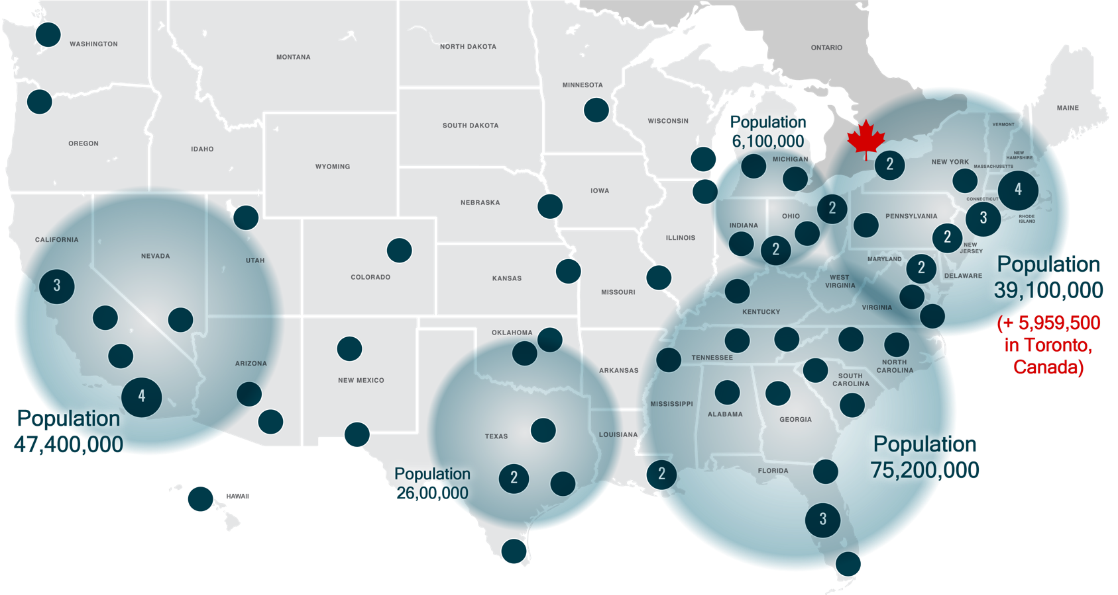
MSA Top 75
*Populations are based on approximate numbers

Slide 18
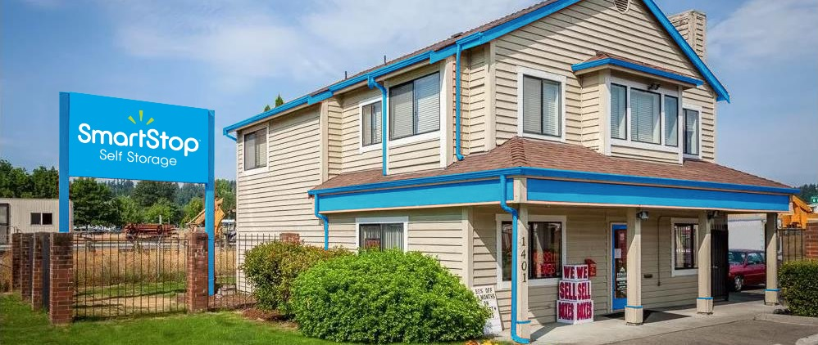

Acquisitions
1401 N Meridian
Puyallup, Washington
2555 W Centennial Pkwy.
North Las Vegas, Nevada
830 Units
98,000 NRSF
Approx. 90% Occupancy*
Purchase Price: $13,600,000
640 Units
76,500 NRSF
Approx. 92% Occupancy*
Purchase Price: $12,800,000
*Occupancy number as of 11/30/2019
*Occupancy number as of 11/30/2019

Slide 19
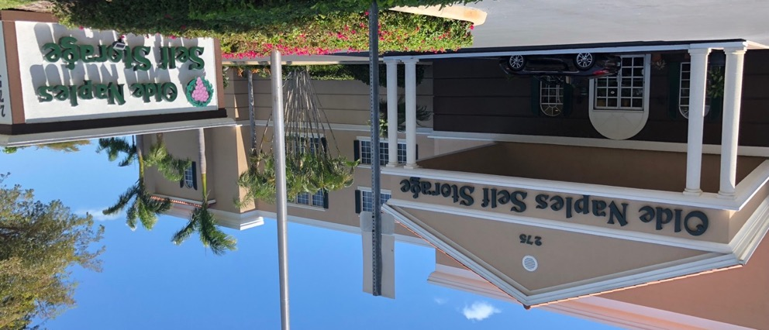
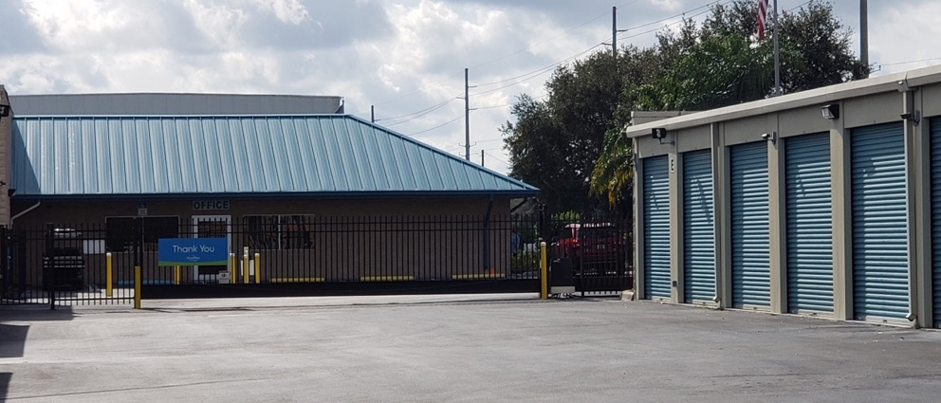
Acquisitions
275 Goodlette-Frank Rd. N.
Naples, Florida
1610 Jim Johnson Rd.
Plant City, Florida
700 Units
77,900 NRSF
Approx. 92% Occupancy*
Purchase Price: $27,250,000
960 Units
190,000 NRSF
Approx. 84% Occupancy*
Purchase Price: $14,500,000
*Occupancy number as of 11/30/2019
*Occupancy number as of 11/30/2019

Slide 20
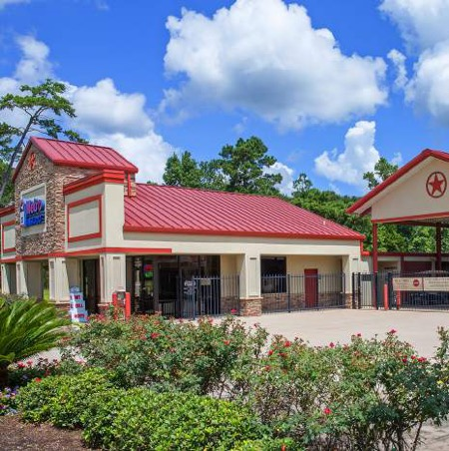
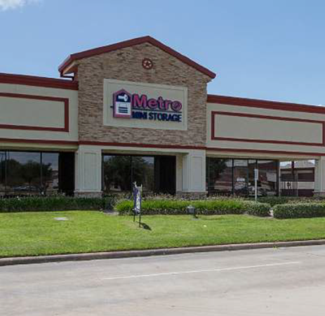
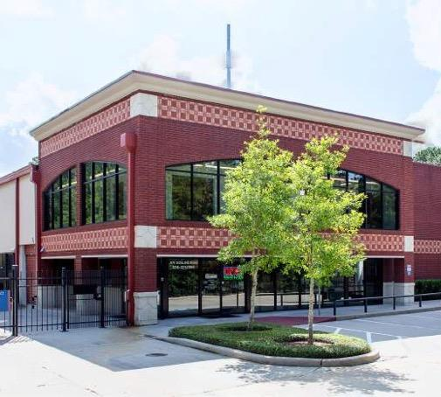
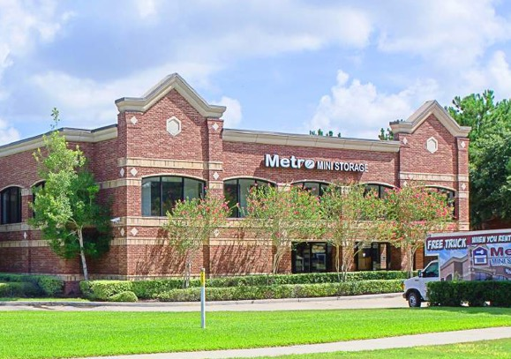
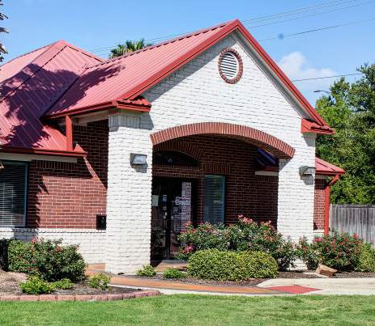
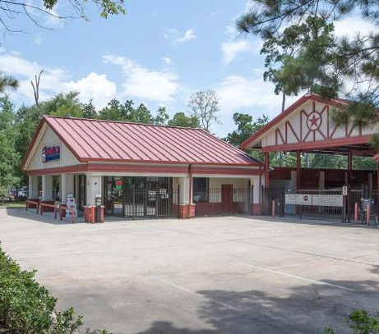
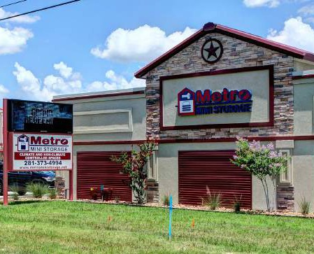
Acquisitions
Metro Mini Portfolio
7 Properties
4,130 Units
545,900 NRSF
Approx. 88% Occupancy*
Purchase Price: $58.5M
*Occupancy number as of 11/30/2019

Slide 21
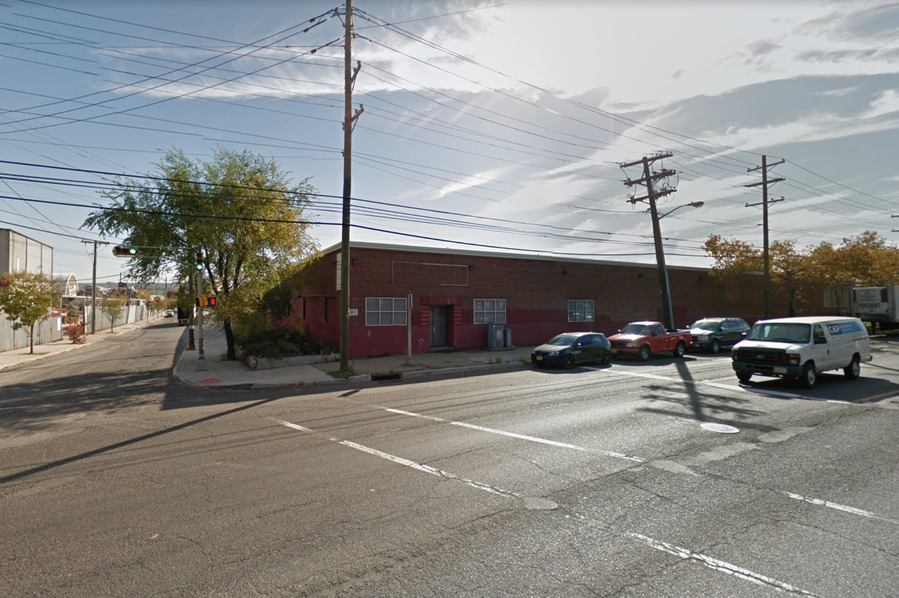
Recent Acquisition
99 Evergreen Avenue
Newark, New Jersey
1,900 Units
158,000 NRSF
Approx. 87% Occupancy*
Purchase Price: $30,000,000
*Occupancy number as of 6/30/2019

Slide 22
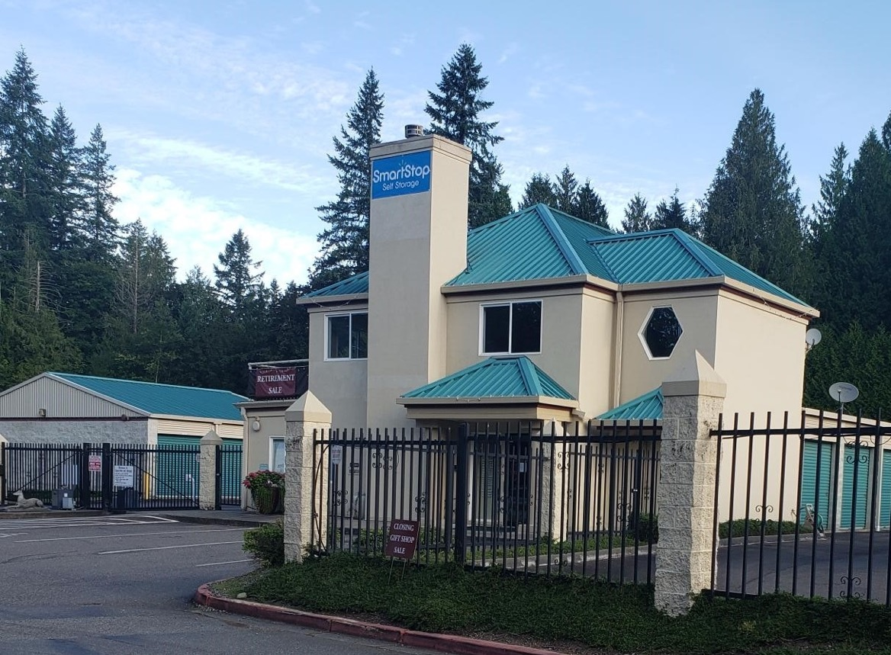
Recent Acquisition
23316 Redmond-Fall City Rd NE
Redmond, Washington
350 Units
48,000 NRSF
Approx. 85% Occupancy*
Purchase Price: $11,500,000
*Occupancy number as of 11/30/2019

Slide 23
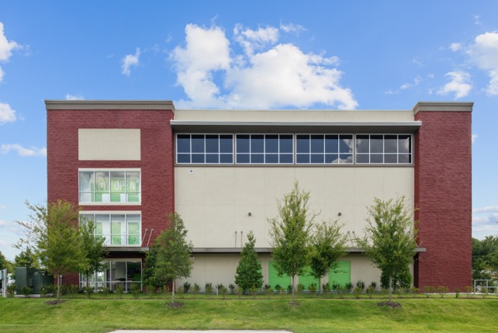
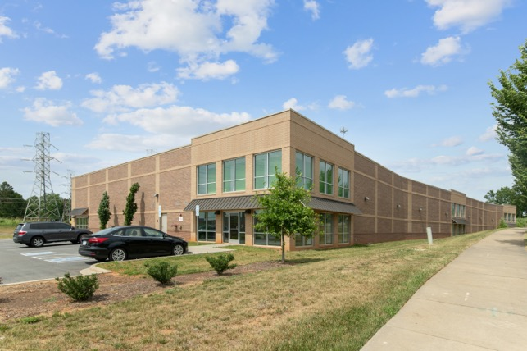
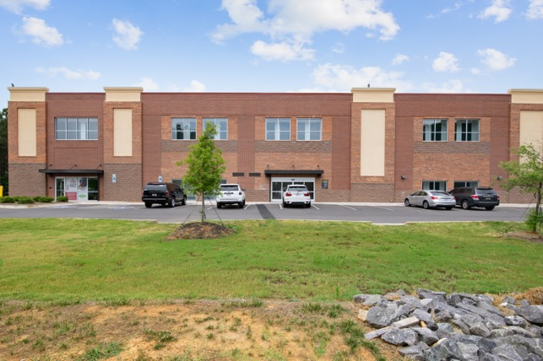
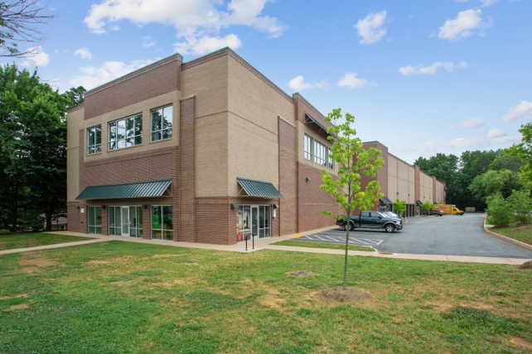
Recent Acquisitions
Taylor Theus Portfolio
3,510 Units
325,700 NRSF
Approx. 61% Occupancy*
Purchase Price: $64.5M
Ocoee, Florida
Charlotte, North Carolina
*Occupancy number as of 11/30/2019
2 properties currently in lease up
Charlotte, North Carolina
Charlottesville, Virginia

Slide 24
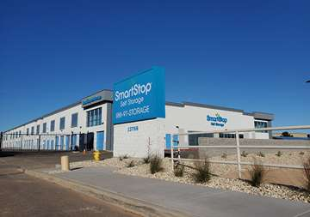
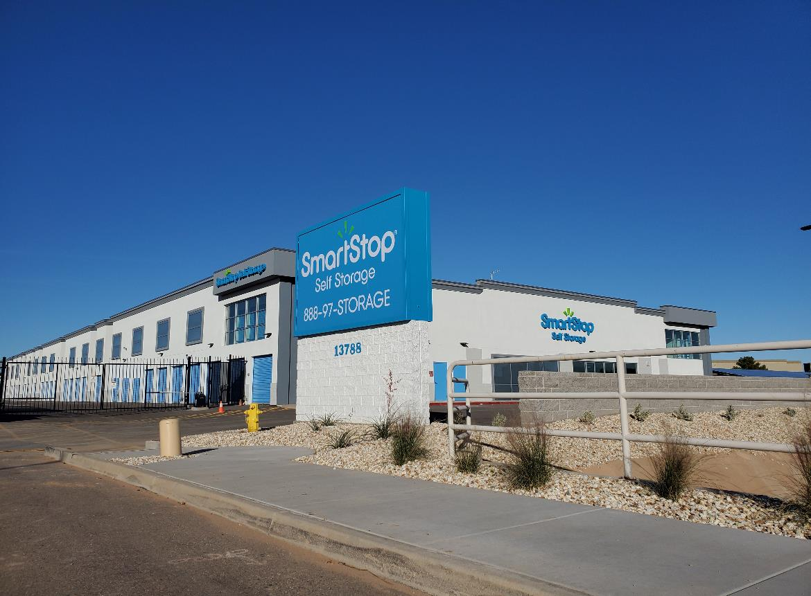
Recent Acquisition
13788 W. Greenway Rd
Surprise, Arizona
716 Units
78,775 NRSF
Approx. 5% Occupancy*
Purchase Price: $7,825,000
*Occupancy number as of 1/05/2020
Acquired at C of O 12/17/2019

Slide 25







Strategic Storage Trust IV, Inc. Goals
Hedge Against
Inflation & Increasing
Interest Rates
(Due to month to month rents)
Goal of Meeting
Current & Future
Income Needs
Monthly
Distributions⁽¹⁾
No Tenant
Improvements /
Leasing Commissions⁽³⁾
3-5 Year Anticipated
Hold After Completion
of Offerings⁽⁴⁾
Capital
Appreciation
(1) We expect to pay distributions from sources other than cash flow from operations. Therefore, we will have fewer funds available for acquisitions of properties and our stockholders overall return may be reduced. Future distributions are at the sole discretion of our board of directors and are not guaranteed. Distributions on Class T shares and Class W shares will be lower than distributions on Class A shares because Class T shares are subject to the ongoing stockholder servicing fee and Class W shares are subject to the ongoing dealer manager servicing fee.
Demand for storage is driven by major demographic trends which are going to happen regardless of GDP growth rates, unemployment or what the S&P 500 is doing accordingly, [self] storage is recession resistant.” Source: “Gates: Recession-resistant property is best for investors” - Austin Business Journal by Cody Lyon, Staff Writer, September 2011. Past performance is no indication of future results. It is possible to lose money on this investment. While the self storage industry may be resistant to recessions, there is no guarantee that a related investment will realize a profit or prevent against loss.
We will not pay commissions in connection with the leasing of our self storage units; however, we will pay certain fees associated with the day – to day management and operations of our self storage facilities.
The timing of our exit strategy is subject to market conditions and the discretion of our Board of Directors. There is no assurance that we will achieve one or more of the liquidity events we intend to seek within this time frame or at all. Our offering may last up to 3 years and our Board of Directors may determine that it is in the best interest of our stockholders to conduct a follow-on offering, in which case offerings of our common stock could be conducted for 6 years or more.
Recession
Resistant⁽²⁾

Slide 26







Strategic Storage Trust IV, Inc. Offering Terms
Suitability⁽¹⁾:
1099 Reporting
A purchaser of shares must have, excluding the value of purchaser’s home, furnishings, and automobiles, either:
Share Redemption Program⁽²⁾
A net worth of at least $250,000; or
A gross annual income of at least $70,000 and a net worth of at least $70,000.
Distribution Reinvestment Plan
Available for IRAs
$5,000 Minimum Investment
($1,500 for IRAs)
Share Classes (A, T, W)
⁽¹⁾ Please see the prospectus for a full description of suitability standards. Residents of Alabama, Iowa, Kansas, Kentucky, Maine, Massachusetts, Missouri, Nebraska, New Jersey, North Dakota, Ohio, Oregon, Pennsylvania, Tennessee and Vermont should consult the prospectus for details regarding the more stringent suitability standards that apply to them based on their states of residence.
⁽²⁾ The share redemption program has a number of limitations including that, during any calendar year, we will not redeem in excess of 5% of the weighted average number of shares outstanding during the prior calendar year. Redemptions will be funded solely from proceeds from our distribution reinvestment plan. If we exceed any limitations in any period, some redemption requests may not be honored. Until our board of directors approves an estimated net asset value per share, as published from time to time in an Annual Report on Form 10-K, a Quarterly Report on Form 10-Q and/or a Current Report on Form 8-K publicly filed with the SEC, the per share price for the repurchase of shares shall be equal to the net investment amount of our shares, which will be based on the “amount available for investment” percentage, assuming the maximum amount of our public offering is raised, shown in the estimated use of proceeds table in our prospectus in effect as of the investor’s purchase date. Additionally, our Board of Directors may choose to amend, suspend or terminate the program upon 30 days notice at any time. See our prospectus for further details regarding our share redemption program.

Slide 27



Recap
Self Storage
Asset Class
Our Sponsor /
Executive Team
A Case
for Growth
Unique Ability to Add Value.
Inflation & Recession Resistant⁽¹⁾
Successful Track Record / Liquidity Event for Shareholders
A Key Portfolio Component
(1) The self storage industry is considered to be more protected from inflation due to its rentals being month to month and its ability to change rates monthly, Self Storage ”Industry Fact Sheet” (7/15). “Demand for storage is driven by major demographic trends which are going to happen regardless of GDP growth rates, unemployment or what the S&P 500 is doing. . . accordingly, [self] storage is recession resistant.” Source: “Gates: Recession-resistant property is best for investors” - Austin Business Journal by Cody Lyon, Staff Writer, September 2011. Past performance is no indication of future results. It is possible to lose money on this investment. While the self storage industry may be resistant to recessions, there is no guarantee that a related investment will realize a profit or prevent against loss.

Slide 28
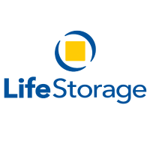








Self Storage Companies
Publicly Traded Self Storage Companies
NYSE: PSA
NYSE: LSI
NYSE: UHAL
NYSE: EXR
NYSE: CUBE
NYSE: JCAP
NYSE: NSA
Public Non-Traded Self Storage REITs
- OFFERING CLOSED -
- OFFERING OPEN -

Slide 29
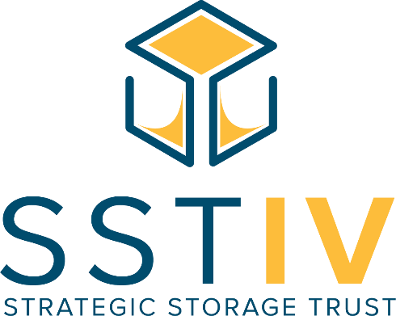

Next Steps

Slide 30
Main Office
10 Terrace Road
Ladera Ranch, CA 92694
Sales Desk
877.32.REIT5 (877.327.3485)
info@strategicREIT.com
Company Info: StrategicREIT.com
Storage Rentals: SmartStopSelfStorage.com
Investor Services
866.418.5144

Slide 31
Questions?

