Slide 1
Strategic Student & Senior Housing Trust, Inc.

Slide 2
Risk Factors & Other Information
An investment in our shares of common stock involves various risks and uncertainties. You should carefully consider the following risk factors in conjunction with the other information contained in the prospectus before purchasing our shares of common stock. The risks discussed in the prospectus can adversely affect our business, operating results, prospects, and financial condition. These risks could cause the value of our shares to decline and could cause you to lose all or part of your investment. The risks and uncertainties described below are not the only ones we face but do represent those risks and uncertainties that we believe are material to our business, operating results, prospects, and financial condition. Additional risks and uncertainties not presently known to us or that we currently deem immaterial may also harm our business.
See our Form S-11 and recent Form 10-Qs for specific risks associated with an investment in Strategic Student & Senior Housing Trust, Inc.
We incurred a net loss attributable to common stockholders of approximately $14.8 million for the nine months ended September 30, 2019. Our accumulated deficit was approximately $37.1 million as of September 30, 2019. Given that we are still early in our fundraising and acquisition stage, our operations may not be profitable in 2019.
We have paid distributions from sources other than our cash flows from operations, including from the net proceeds of our public offering, including our distribution reinvestment plan. We are not prohibited from undertaking such activities by our charter, bylaws, or investment policies, and we may use an unlimited amount from any source to pay our distributions, and it is likely that we will continue to use public offering proceeds to fund a majority of our early distributions. For the year ended December 31, 2017, we funded 73.8% of our distributions using proceeds from our Primary Private Offering and 26.2% using proceeds from our distribution reinvestment plan. For the year ended December 31, 2018, we funded 12.9% of our distributions using cash flows from operations, 50.6% using proceeds from our public and private offerings and 36.5% using proceeds from our distribution reinvestment plan. For the nine months ended September 30, 2019, we funded 50.1% of our distributions using cash flows from operations, 17.1% using proceeds from our public and private offerings and 32.8% using proceeds from our distribution reinvestment plan. Payment of distributions in excess of earnings may have a dilutive effect on the value of our shares. If we pay distributions from sources other than cash flow from operations, we will have fewer funds available for acquiring properties, which may reduce our stockholders’ overall returns. Additionally, to the extent distributions exceed cash flow from operations, a stockholder’s basis in our stock may be reduced and, to the extent distributions exceed a stockholder’s basis, the stockholder may recognize a capital gain.
No public market currently exists for shares of our common stock and we may not list our shares on a national securities exchange before three to five years after completion of our public offering, if at all; therefore, it may be difficult for our stockholders to sell their shares. If our stockholders sell their shares, it will likely be at a substantial discount. Our charter does not require us to pursue a liquidity transaction at any time.
Until we generate operating cash flows sufficient to pay distributions to our stockholders, we may pay distributions from financing activities, which may include borrowings in anticipation of future cash flows or the net proceeds of our offerings (which may constitute a return of capital). Therefore, it is likely that some or all of the distributions that we make will represent a return of capital to our stockholders, at least in the first few years of operation. We are not prohibited from undertaking such activities by our charter, bylaws or investment policies, and we may use an unlimited amount from any source to pay our distributions, and it is likely that we will use offering proceeds to fund a majority of our initial distributions.
This is an initial public offering and we have limited operating history.
The prior performance of real estate programs sponsored by our sponsor or its affiliates may not be indicative of our future results.
This is a “best efforts” offering. If we are unable to raise substantial funds in our public offering, we may not be able to invest in a diverse portfolio of real estate and real estate-related investments, and the value of our stockholders’ investment may fluctuate more widely with the performance of specific investments.
We are a “blind pool” because we have not identified any properties to acquire with the net proceeds from our public offering. As a result, our stockholders will not be able to evaluate the economic merits of our future investments prior to their purchase. We may be unable to invest the net proceeds from our public offering on acceptable terms to investors, or at all.
Investors in our public offering will experience immediate dilution in their investment primarily because pursuant to our private offering, we sold approximately 10.7 million shares of our common stock at a weighted average purchase price of approximately $8.55 per share and received weighted average net proceeds of approximately $7.93 per share in our private offering.
A portion of the proceeds received in our public offering may be used to honor share redemption requests from our stockholders which will reduce the net proceeds available to acquire additional properties.
There are substantial conflicts of interest among us and our sponsor, advisor, affiliated property manager, transfer agent and dealer manager.
Our advisor may face conflicts of interest relating to the purchase of properties and such conflicts may not be resolved in our favor, which could adversely affect our investment opportunities.
We have no employees and must depend on our advisor to select investments and conduct our operations, and there is no guarantee that our advisor will devote adequate time or resources to us.
We will pay substantial fees and expenses to our advisor, its affiliates and participating broker-dealers, which will reduce cash available for investment and distribution.
We may incur substantial debt, which could hinder our ability to pay distributions to our stockholders or could decrease the value of our stockholders’ investment.
We may fail to qualify as a REIT, which could adversely affect our operations and our ability to make distributions.
Our board of directors may change any of our investment objectives without our stockholders’ consent.

Slide 3
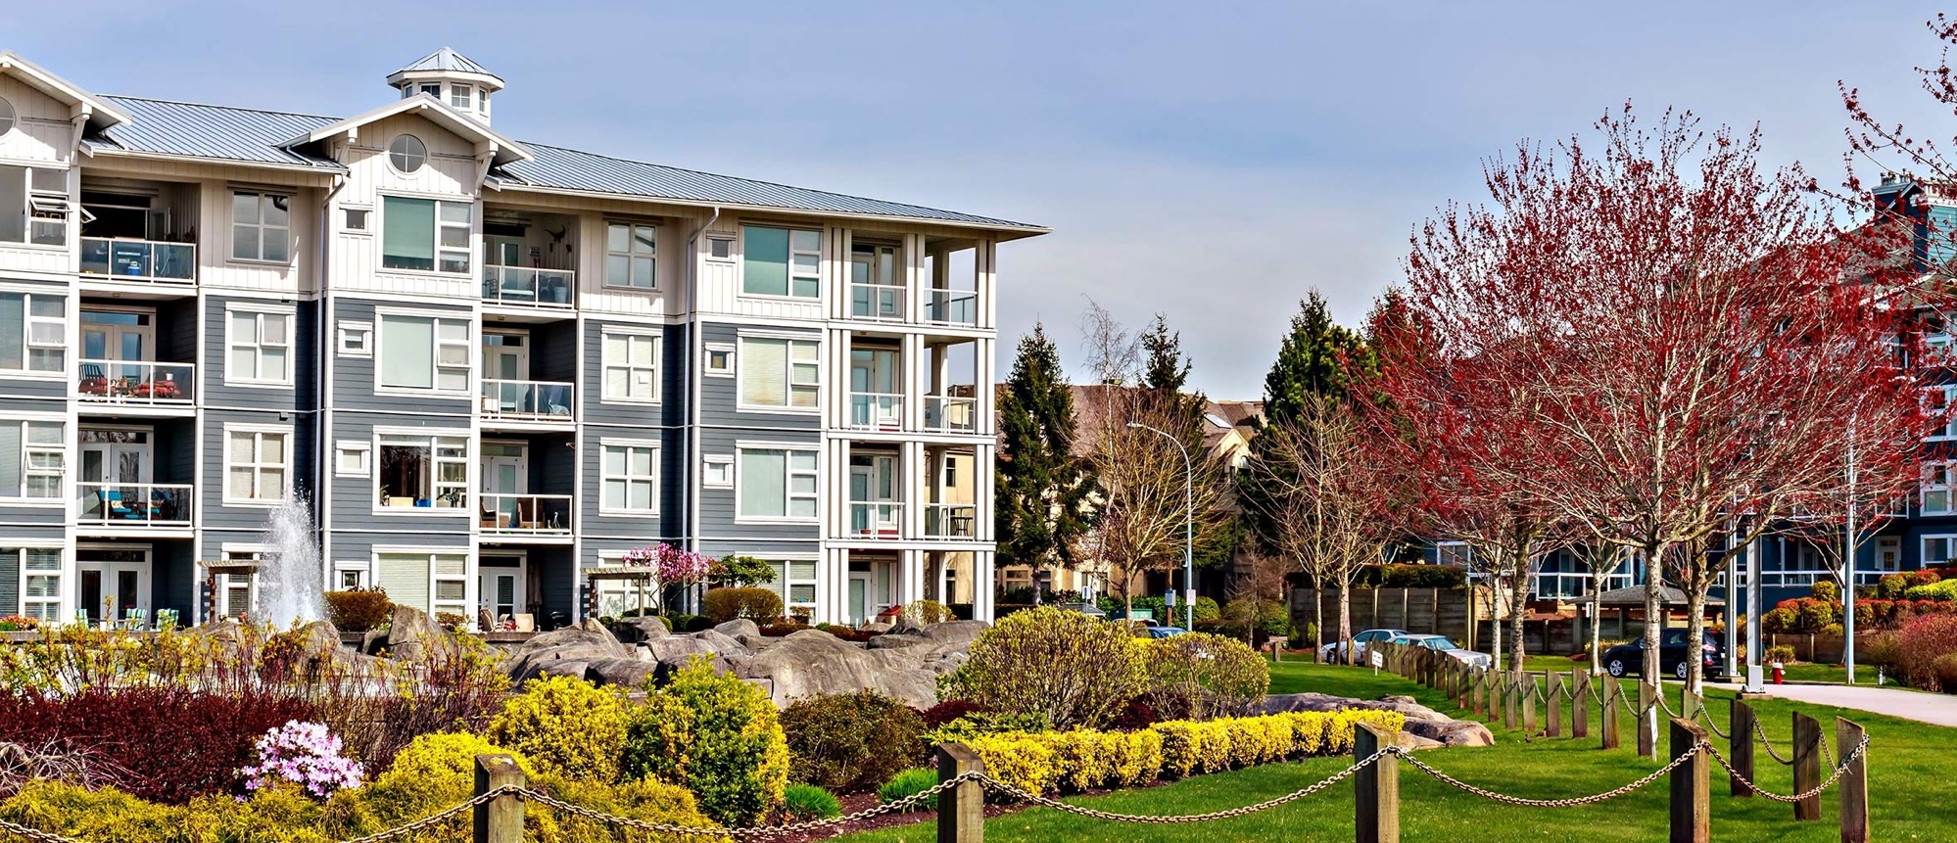



Agenda
SmartStop Asset Management, LLC
Student & Senior Housing Overview
Strategic Student & Senior Housing Trust, Inc.

Slide 4
SmartStop Asset Management, LLC

Slide 5
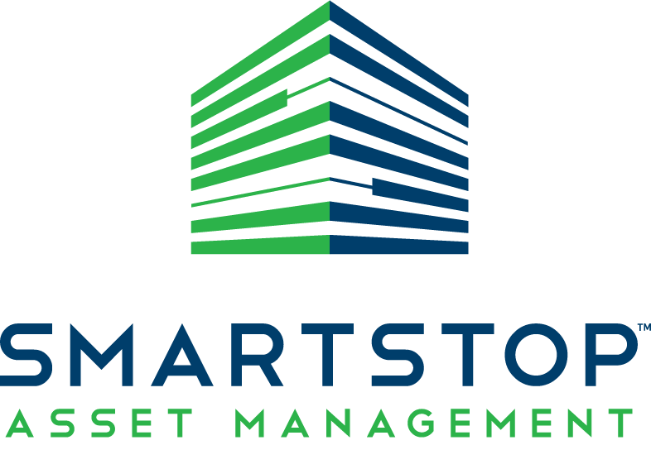
SmartStop Asset Management, LLC
SmartStop Asset Management, LLC (“SAM”) and its affiliates* have a managed real estate portfolio of approximately $2.0 billion.
An affiliate* of SAM sponsors, advises and manages one public, non-traded REIT and one private REIT focusing on self storage properties
Growing self storage portfolio of properties in the greater Toronto area, comprising over 1 million net rentable square feet
Company and affiliates have acquired over $6 billion in real estate assets over the past 15 years
National sponsor of 1031 DST programs
Current managed portfolio comprises approx. 12.0 million rentable square feet across 22 states & Toronto, Canada
SAM and its affiliates have an aggregate of over 380 employees, including 42 self storage employees in Toronto, Canada
Experienced developer of self storage and mixed-use properties in the U.S. and Toronto, including ground up & redevelopment projects
Sponsor of public, non-traded REIT investing in student & senior housing
*Self Storage REITs are sponsored by SmartStop REIT Advisors, LLC., an affiliate of SAM

Slide 6


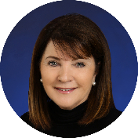

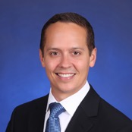
Strategic Student & Senior Housing Trust, Inc. Executive Team
H. Michael Schwartz Chairman of the Board & Chief Executive Officer
John Strockis President & Chief Investment Officer
Paula Mathews Executive Vice President
James Berg Secretary
Mike Crear Chief Financial Officer & Treasurer

Slide 7
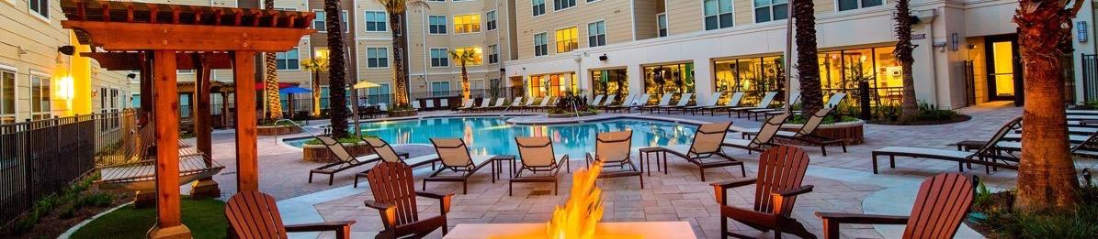



Why?
Student Housing
Senior Housing
v
 | Alternative Asset Class | ✓ | ✓
 | Fragmented Ownership | ✓ | ✓
 | Operating Business/Economies of Scale | ✓ | ✓
 | Brand-based Real Estate
 | Recession-resistant Traits¹ | ✓ | ✓
 | Inflation/Interest Rate Hedge² | ✓ | ✓
The Domain at Tallahassee, Florida State University Student Housing
The Charleston, Cedar Hills, Utah
³
The student housing industry has proven to be a recession resistant sector, even when compared to other residential real estate. Green Street Advisors, a leading real estate research firm, found that student housing was “one of only three sectors where Market Revenue per Available Foot did not decline during the Global Financial Crisis, primarily due to the fact that enrollment at four-year colleges grew two percent per annum from 2006 – 2009; Green Street Advisors, June 28, 2013. Senior housing consistently outperformed all other classes of commercial real estate from 2007 - 2017.25 People need healthcare and aging services regardless of economic condition. Even during the economic downturn of 2008 the occupancy rate for senior housing was never significantly below 90%; Healthcare Business Today, “Senior Housing: Is It Still a Smart Investment?” July 26, 2017 by Jess Stonefield. Past performance is no indication of future results. It is possible to lose money on this investment. While the student housing and senior housing industries may be resistant to recessions, there is no guarantee that a related investment will realize a profit or prevent against loss.
As a non-traded REIT, leases with our tenants include the potential for increased rent payments based on inflation so that rents will increase should inflation accelerate.
The “YOUnion” brand and its associated trademarks are owned by our sponsor.

Slide 8
Student & Senior Housing Overview

Slide 9




Characteristics That Drive Returns
The Domain at Tallahassee, Florida State University
The Charleston, Cedar Hills, Utah
Recession-Resistant Characteristics¹
Diversification By: Geography, Asset Type, & Demographics
Highly Fragmented Sectors With Consolidation Opportunities
Student Housing
Senior Housing
Anchored by the stability of major universities
Majority of leases backed by parents/financial aid
Supply constrained markets (on- & off-campus)
Limited government funding for new dorms & enhancements
Aligning housing and healthcare
Favorable Net Operating Income (NOI)²
Short supply of senior housing properties
Leases are backed by private pay and/or long-term care insurance/benefits
The student housing industry has proven to be a recession resistant sector, even when compared to other residential real estate. Green Street Advisors, a leading real estate research firm, found that student housing was “one of only three sectors where Market Revenue per Available Foot did not decline during the Global Financial Crisis, primarily due to the fact that enrollment at four-year colleges grew two percent per annum from 2006 – 2009; Green Street Advisors, June 28, 2013. Senior housing consistently outperformed all other classes of commercial real estate from 2007 - 2017.25 People need healthcare and aging services regardless of economic condition. Even during the economic downturn of 2008 the occupancy rate for senior housing was never significantly below 90%; Healthcare Business Today, “Senior Housing: Is It Still a Smart Investment?” July 26, 2017 by Jess Stonefield. Past performance is no indication of future results. It is possible to lose money on this investment. While the student housing and senior housing industries may be resistant to recessions, there is no guarantee that a related investment will realize a profit or prevent against loss.
Green Street Advisors projects that senior housing will outpace the broader major-sector NOI averages in 2020, 2021, and 2022; pwc and Urban Land Institute, Emerging Trends in Real Estate 2019.

Slide 10

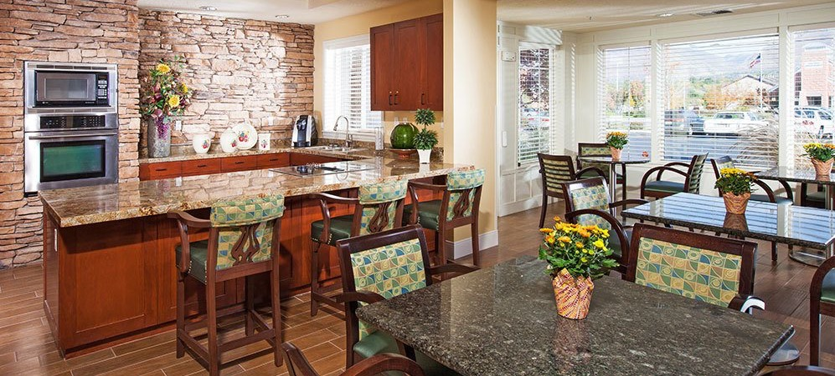
Factors Driving Demand
Student Housing
Senior Housing
Steady enrollment increase at major universities
Proximity to campus
Outdated on-campus dormitories
Generation Z expectations - desire for more than just a living space
Increase in baby boomer population
Increase in life expectancy
Need for community living & social engagement
Fewer family caregivers
Desire to downsize living space
The District at Fayetteville, University of Arkansas
The Wellington at Salt Lake City, Utah
Enrollment is expected to increase by approximately 500,000 students between 2017 and 2028.*
By 2029, when all baby boomers will be 65 years or older, more than 20% of the U.S. population will be over the age of 65.*
*National Center of Educational Statistics
*U.S. Census Bureau

Slide 11
Strategic Student & Senior Housing Trust, Inc.

Slide 12
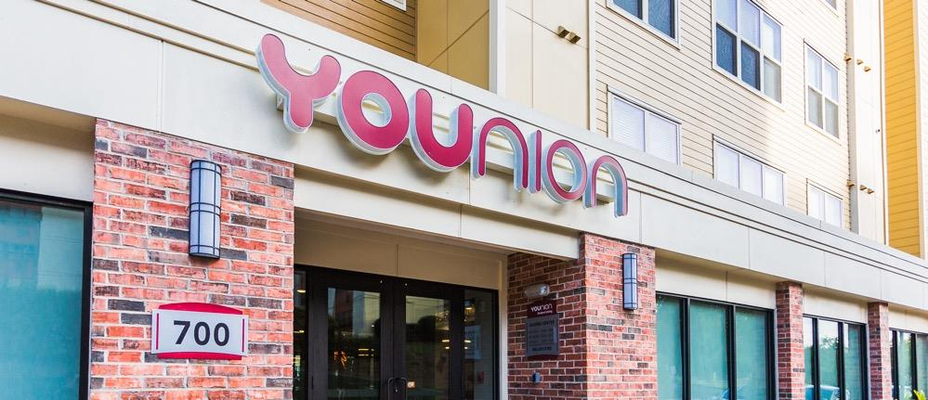

Investment Strategy – Student Housing
The Wellington at Salt Lake City, Utah
YOUnion@Tallahassee
Class “A” properties
Purpose-built, amenities-rich and newer construction
Tier-1 universities (15,000 minimum enrollment)
Convenient pedestrian-to-campus (within one mile)
Division I football program
Carnegie Foundation R1 rating for Very High Research Activity
Lightning-fast, reliable internet connectivity

Slide 13

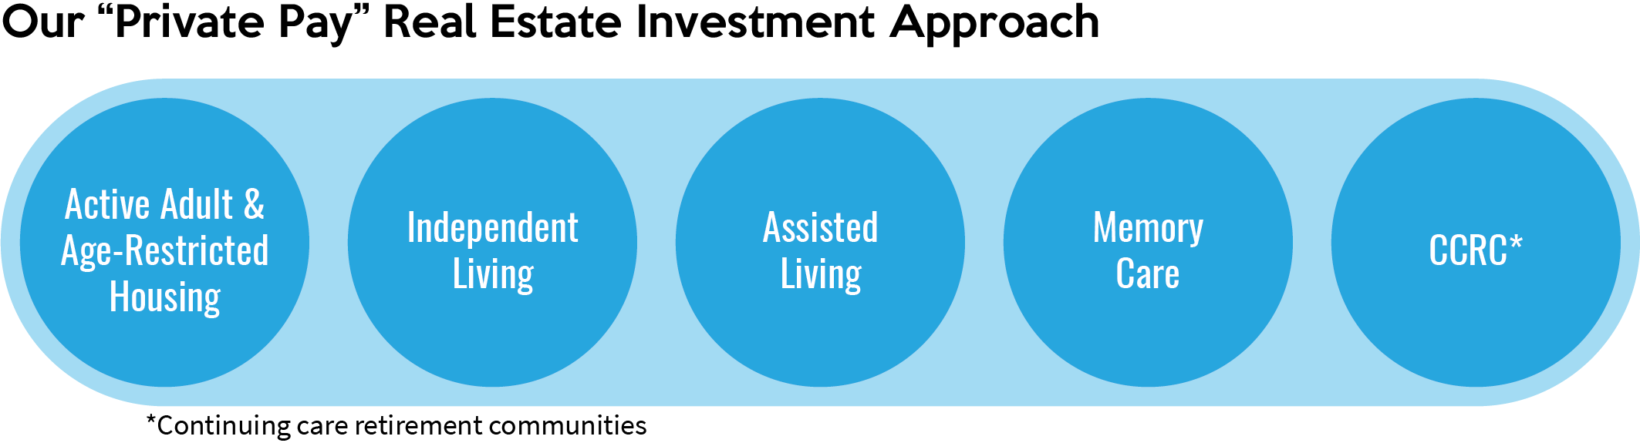
Investment Strategy – Senior Housing
Class “A” properties
Convenient location in proximity to medical services and retail centers
Experienced property management
Amenities-rich and favorable demographic markets
Emphasis on private pay and low-to-mid acuity

Slide 14
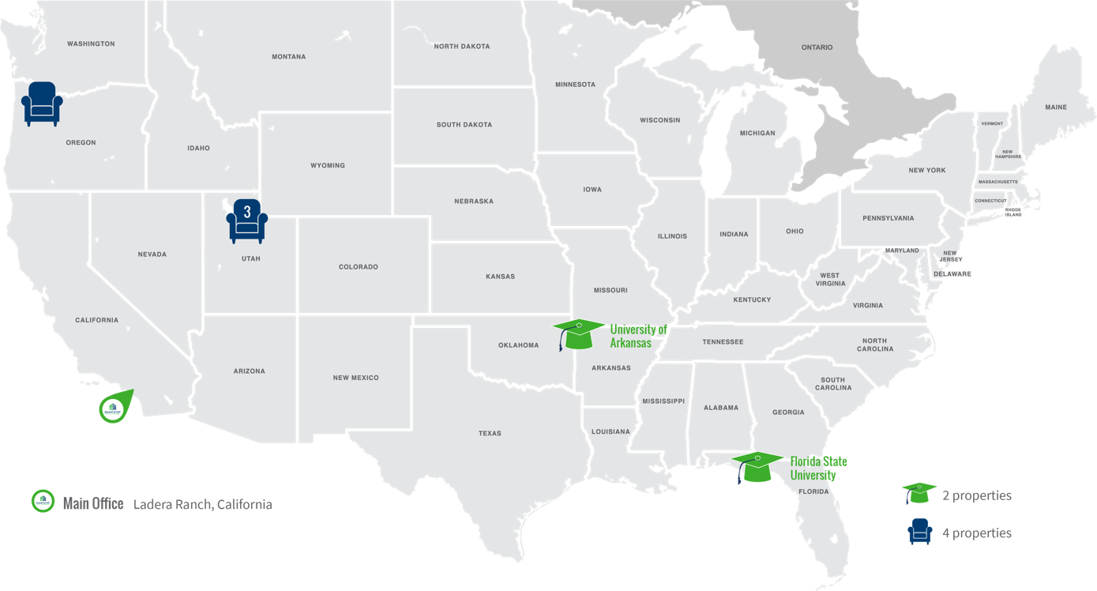
Portfolio Summary

Slide 15

YOUNION – Student Housing Brand*
* The “YOUnion” Brand and its associated trademarks are owned by our sponsor.

Slide 16
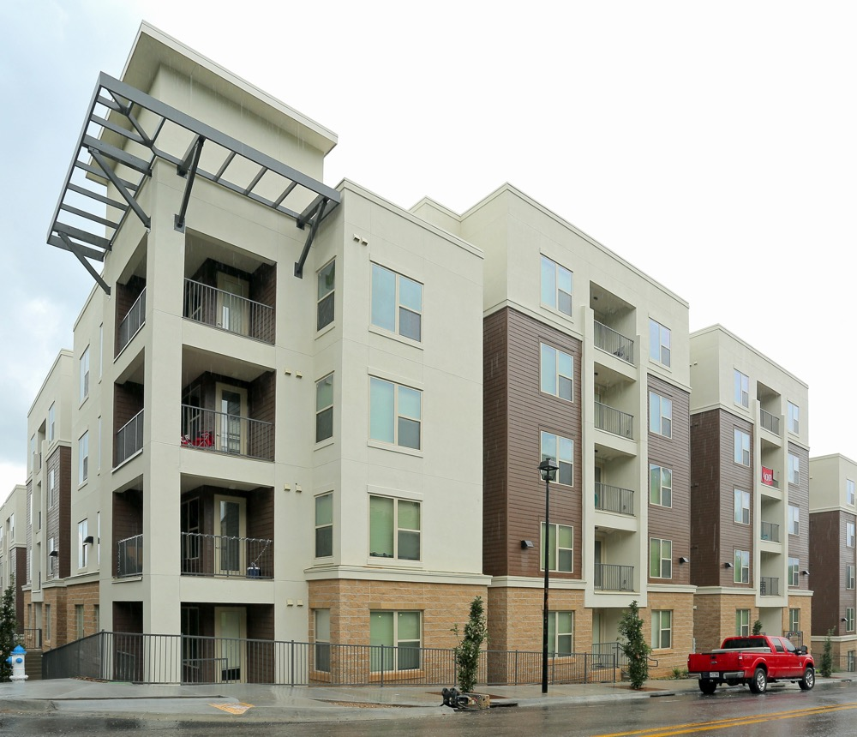

University of Arkansas
Student Housing
$57,000,000 - Acquired June 2017
LEED Gold certified
Newly constructed
Fully furnished units (beds, desks, appliances, washer/dryer)
1 bed/bath parity
3 blocks from University of Arkansas
1 block from dining and entertainment corridor
Fiber optic cable with 500 Mbps of bandwidth
Tier 1-rated Top 129 College

Slide 17
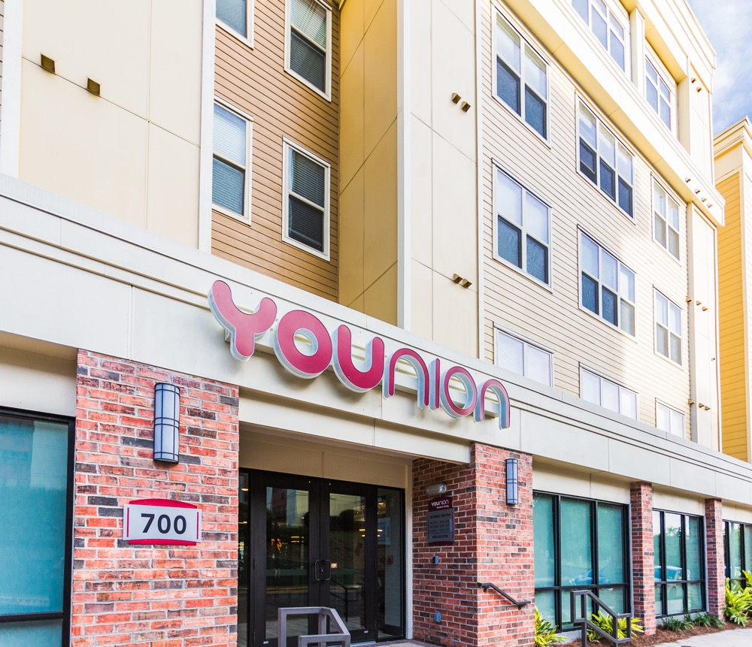

Florida State University
Student Housing
$47,500,000 – Acquired September 2017
Two blocks from Florida State University
Division I football team
Fully furnished units (beds, desks, appliances, washer/dryer)
1 bed/bath parity
Extraordinary amenities package (fitness center, resort style pool, computer center, tanning booth)
Newly constructed
Fiber optic cable with 1 Gigabit of bandwidth
Tier 1-rated Top 99 College

Slide 18
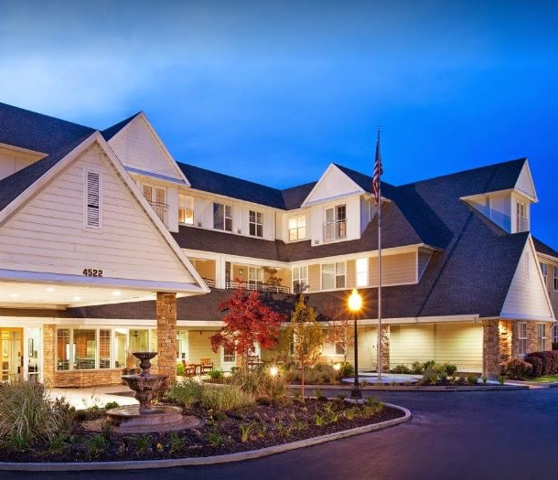
The Wellington, Salt Lake City MSA
Senior Housing
$48,500,000 – Acquired February 23, 2018
119-unit / 140-bed
Upscale assisted living community
24-hour staffing
30 minutes from downtown Salt Lake City
Multiple floor plans
Emergency alert response system
Extraordinary amenities package (fitness center, beauty salon, daily meals, social events, library, computer center, elegant dining room, casual bistro, art studio, common area Wi-Fi)

Slide 19

The Charleston, Cedar Hills, Utah
Senior Housing
$13,000,000 – Acquired February 23, 2018
64-unit / 78-bed
Assisted living community
24-hour staffing
30 minutes from downtown Salt Lake City
Multiple floor plans
Emergency alert response system
Extraordinary amenities package (beautifully landscaped grounds, patio, and walking paths; grand dining room; country bistro/kitchen; parlor with fireplace; library; activity room with piano; theatre room; beauty salon/barber shop; Wi-Fi)

Slide 20

Cottonwood Creek, Salt Lake City MSA
Senior Housing
$17,000,000 – Acquired February 23, 2018
111-unit / 136-bed
Assisted living community
24-hour staffing
Multiple floor plans
Emergency alert response system
Extraordinary amenities package (fitness/rehab center, health enhancing activities, daily meals, walking groups, arts and crafts classes, TED talk debates, elegant dining, casual café, game lounge, beauty salon, barber shop, Wi-Fi)

Slide 21
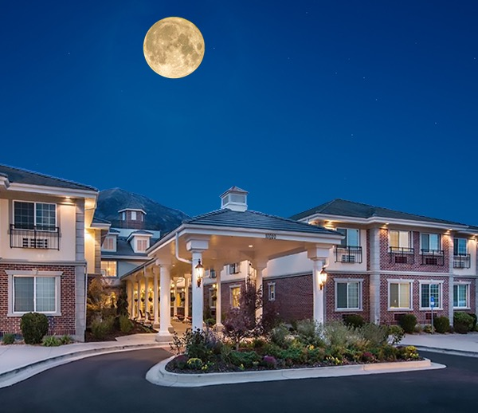
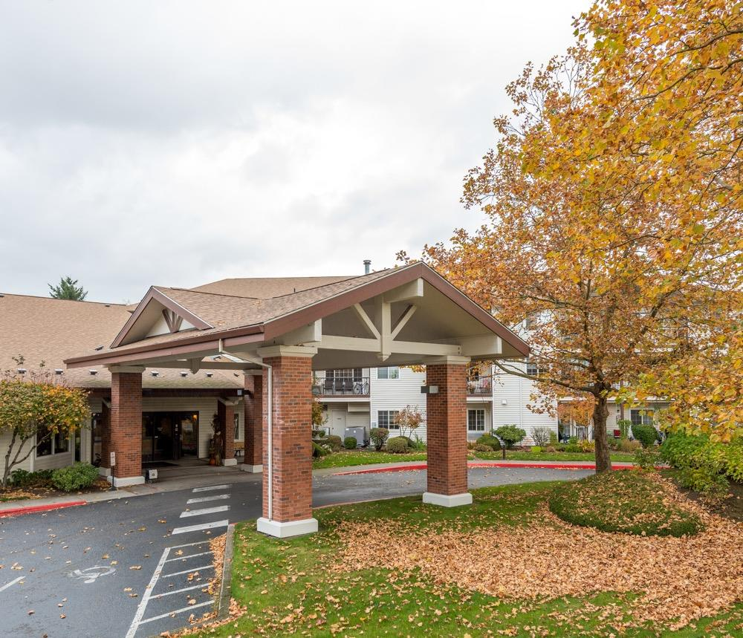
Courtyard at Mount Tabor, Portland, Oregon
Senior Housing
$92,000,000 – Acquired September 4, 2018
Class A, purpose-built assisted living, independent living and memory care community
250,141 square feet, 286-unit / 292-bed
Recently renovated units
Multiple floor plans
Extraordinary amenities package (beautifully landscaped grounds, grand dining room, parlor with fireplace, library, activity rooms, theatre room, beauty salon/barber shop, Wi-Fi)
New 21-unit/29-bed, $10 million memory care expansion

Slide 22
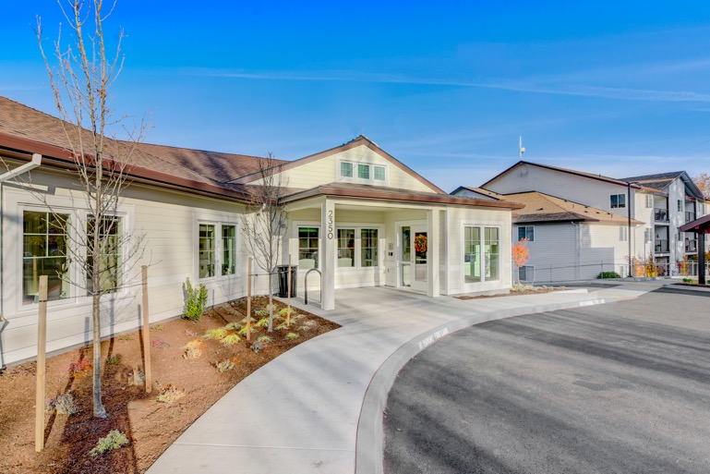

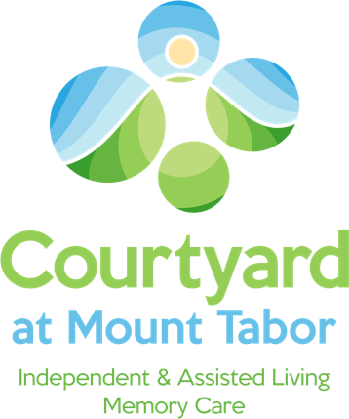
Courtyard at Mt. Tabor Memory Care Expansion
Acuity Type
Units
Beds
Independent Living
Assisted Living
Memory Care (Current)
Memory Care (Expansion)
Total
201
73
12
23
309
201
73
20
29
323

Slide 23






Strategic Student & Senior Housing Trust, Inc. Goals
Brand-Based Real Estate Investment
Recession Resistant¹
Inflation/Interest Rate Hedge²
Goal of Meeting Current & Future Income Needs³
3-5 Year Anticipated Hold After Completion of Offerings⁴
Capital Appreciation Goal
The student housing industry has proven to be a recession resistant sector, even when compared to other residential real estate. Green Street Advisors, a leading real estate research firm, found that student housing was “one of only three sectors where Market Revenue per Available Foot did not decline during the Global Financial Crisis, primarily due to the fact that enrollment at four-year colleges grew two percent per annum from 2006 – 2009; Green Street Advisors, June 28, 2013. Senior housing consistently outperformed all other classes of commercial real estate from 2007 - 2017.25 People need healthcare and aging services regardless of economic condition. Even during the economic downturn of 2008 the occupancy rate for senior housing was never significantly below 90%; Healthcare Business Today, “Senior Housing: Is It Still a Smart Investment?” July 26, 2017 by Jess Stonefield. Past performance is no indication of future results. It is possible to lose money on this investment. While the student housing and senior housing industries may be resistant to recessions, there is no guarantee that a related investment will realize a profit or prevent against loss.
As a non-traded REIT, leases with our tenants include the potential for increased rent payments based on inflation so that rents will increase should inflation accelerate.
Distributions are not guaranteed. Diversification does not ensure a profit or guarantee against a loss.
The timing of our exit strategy is subject to market conditions and the discretion of our board of directors. There is no assurance that we will achieve one or more of the liquidity events we intend to seek within this time frame or at all. Our board of directors may determine that it is in the best interest of our stockholders to conduct a follow-on offering, in which case offerings of our common stock could be conducted for six years or more. Our charter does not provide a date for termination of our corporate existence and does not require us to pursue a liquidity transaction at any time.

Slide 24







Student & Senior Housing REITs
Publicly Traded Competitors
Student Housing
Senior Housing
NYSE: ACC
NYSE: VTR
NYSE:WELL
NYSE:BKD
NYSE:CSU
NYSE:NHI
Public Non-Traded Student & Senior Housing REIT

Slide 25
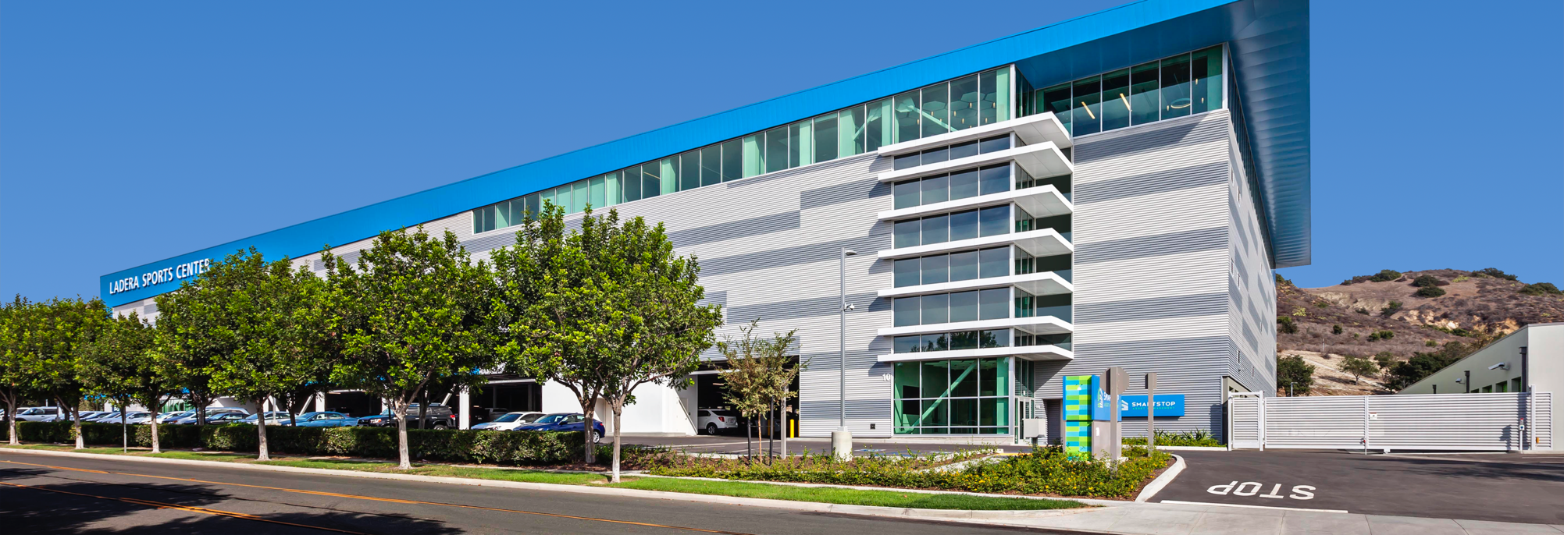
Questions?
This property is owned by SmartStop Asset Management
Main Office:
10 Terrace Road, Ladera Ranch, CA 92694
949.429.6600 | SAM.com | StrategicREIT.com

